Slide 1


Final Presentation
Stock Direction Prediction
Team 003: Itay Mutzafi | Moran Zaks | Shaked Schnarch
Workshop in Data Science |Fall 2025

Slide 2
Agenda
Reminder
Foundations & Baseline (Pre-Checkpoint)
Recent Progress And Main Challenges
Feature Engineering
“Model Zoo” Experiment- Framework
Project status
Project status – Finished tasks
Roadmap And Progress
Benchmarks and Success Criteria
“Model Zoo” Experiment- Results
Feature Selection
Bull & Bear regimes
Project status – Future Directions

Slide 3
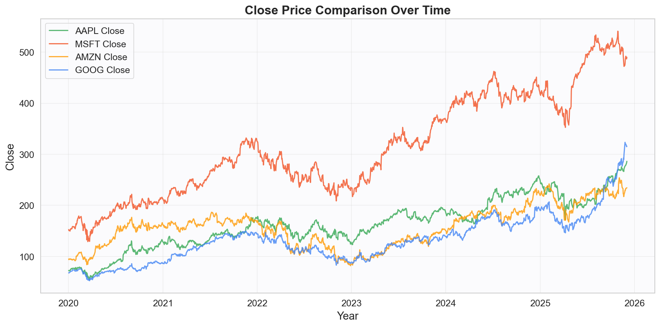
Reminder
The Task: Directional of next-day Logarithmic Returns
Target Universe: Mega-cap technology stocks: AAPL, MSFT, AMZN, and GOOG
Data: Yahoo Finance, News

Slide 4
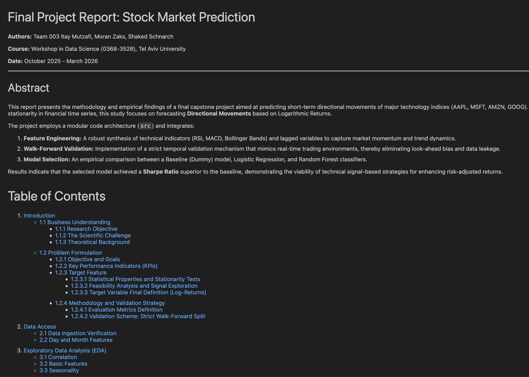
Foundations & Baseline (Pre-Checkpoint)
Problem Formulation: Defined Multi-Task objectives (Regression & Classification) and KPIs
Core Infrastructure: Initialized repository and modular code architecture (src)
EDA and Profiling: Exploratory Data Analysis and statistical profiling of returns
Resource Refinement: Optimized news scraping and FinBERT preprocessing pipelines
Baseline Engineering: Constructed primary OHLCV lags and technical indicators

Slide 5

Roadmap And Progress
Evaluation
22.12 - 19.1
26.10 - 24.11
24.11 - 21.12
21.12 - 19.1
19.1 – 1.3
Business
Understanding
Data Preparation
Model Selection
Finishers

Slide 6
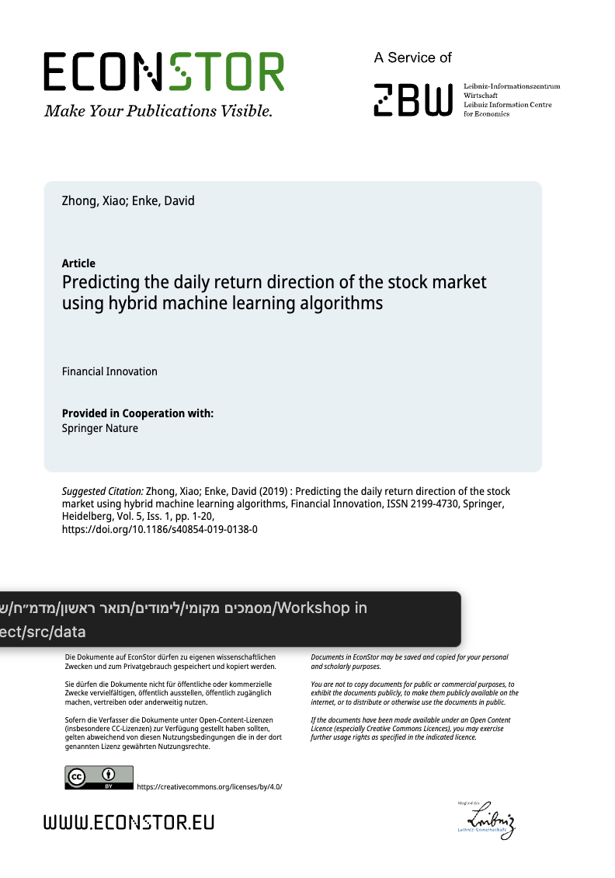
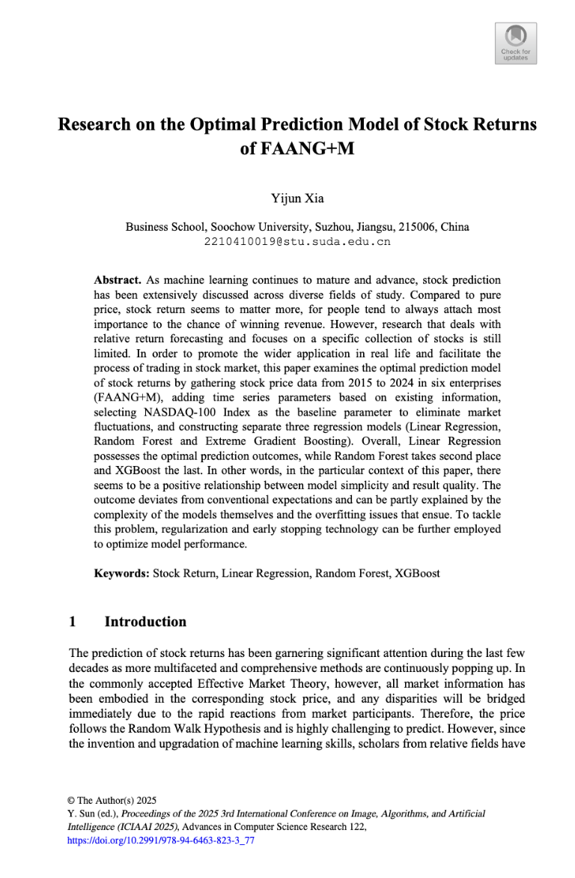
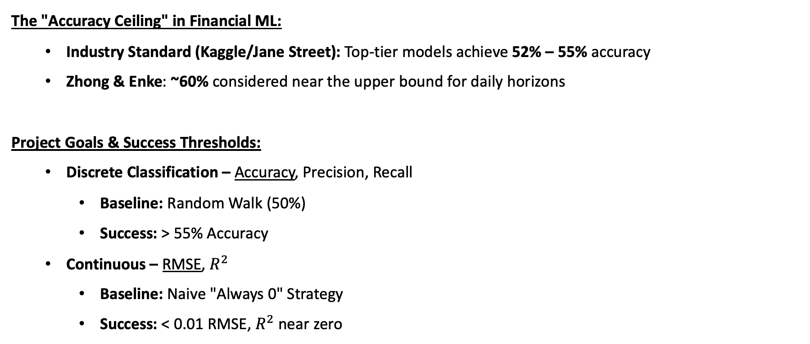
Benchmarks and Success Criteria
The "Accuracy Ceiling" in Financial ML:
Industry Standard (Kaggle/Jane Street): Top-tier models achieve 52% – 55% accuracy
Zhong & Enke: ~60% considered near the upper bound for daily horizons
Project Goals & Success Thresholds:
Discrete Classification – Accuracy, Precision, Recall
Baseline: Random Walk (50%)
Success: > 55% Accuracy
Continuous – RMSE, $R^{2}$
Baseline: Naive "Always 0" Strategy
Success: < 0.01 RMSE, $R^{2}$ near zero

Slide 7
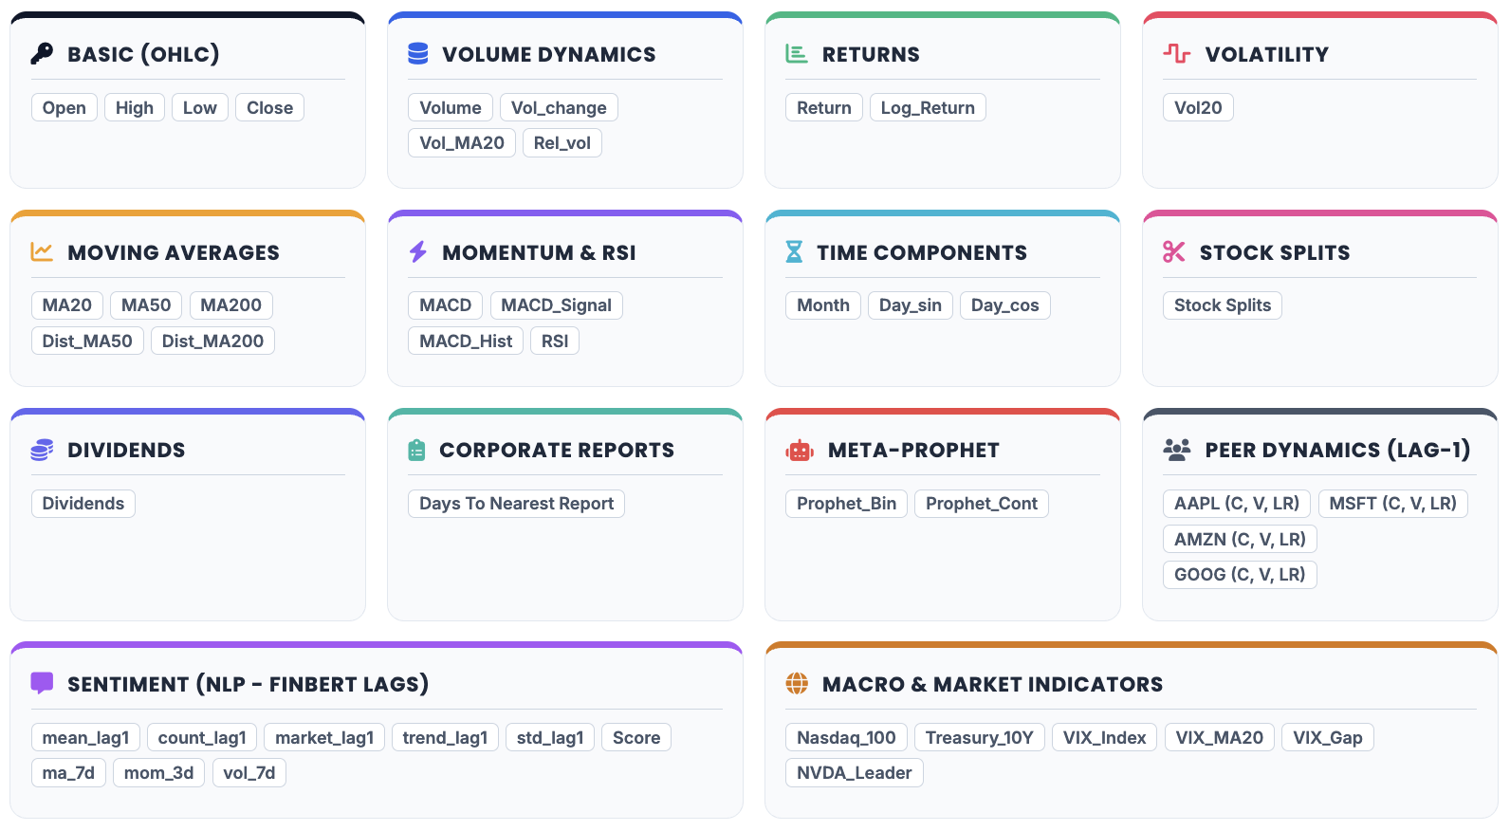
Feature Engineering

Slide 8
Feature Engineering
Interaction Variables
Cleaning
Standardization
Encoding
Automated time frames

Slide 9
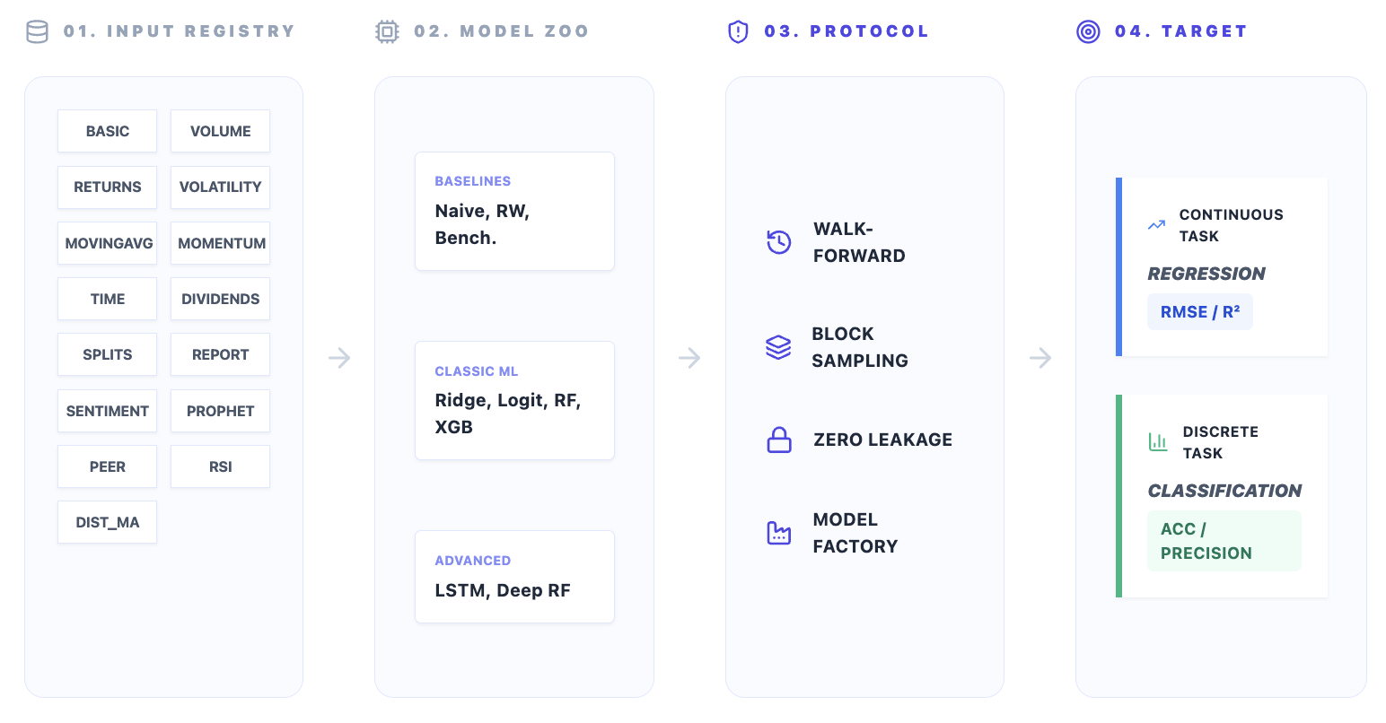
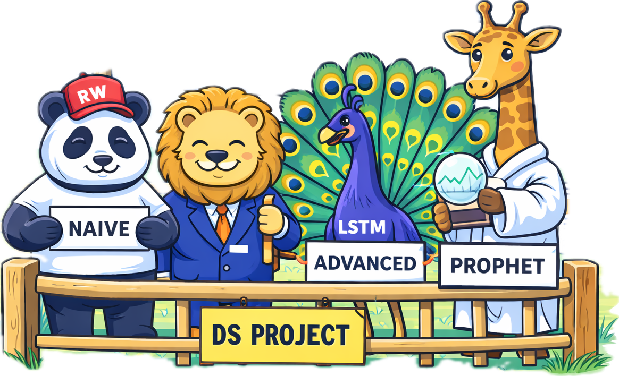
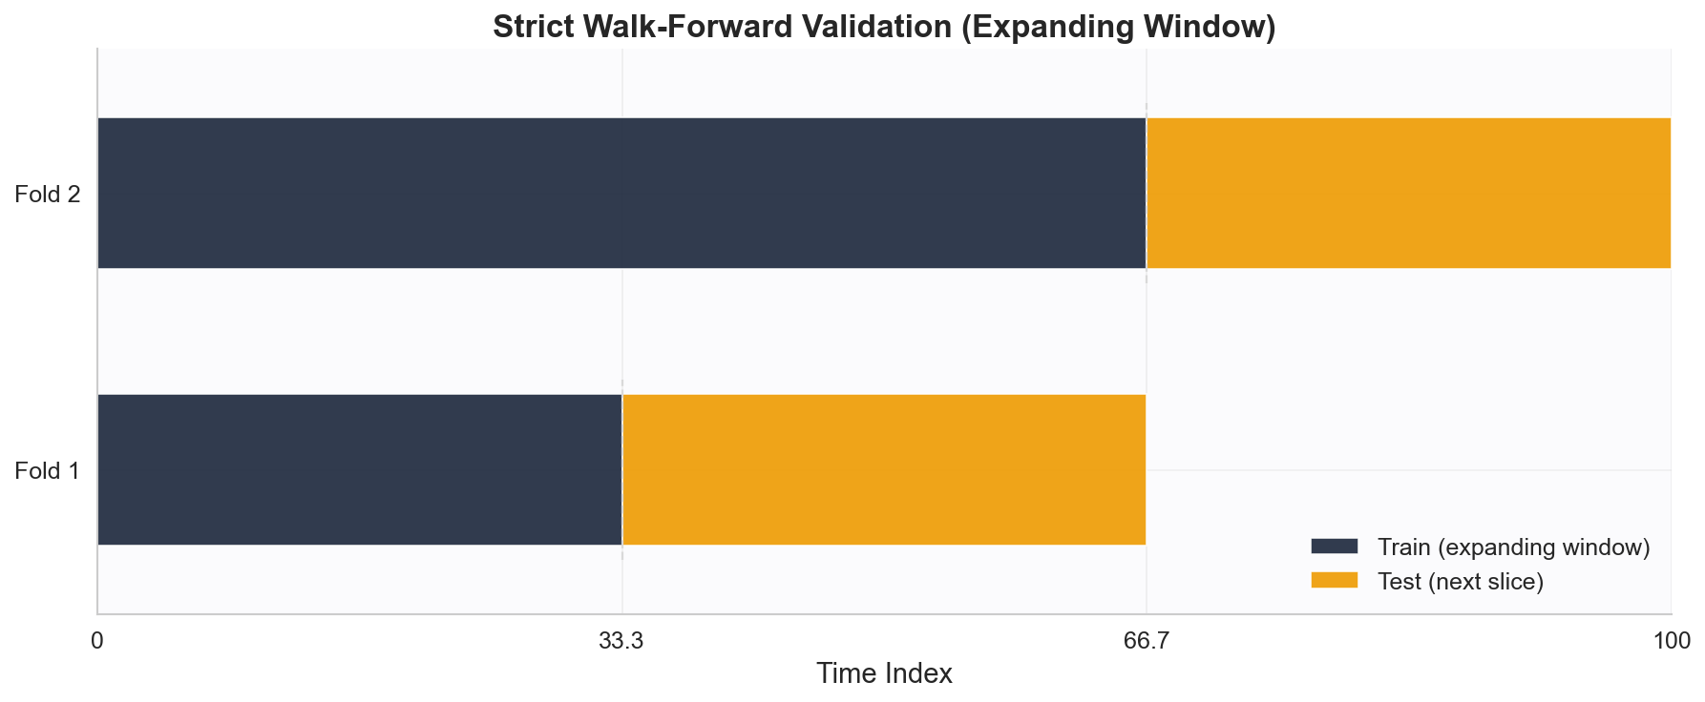
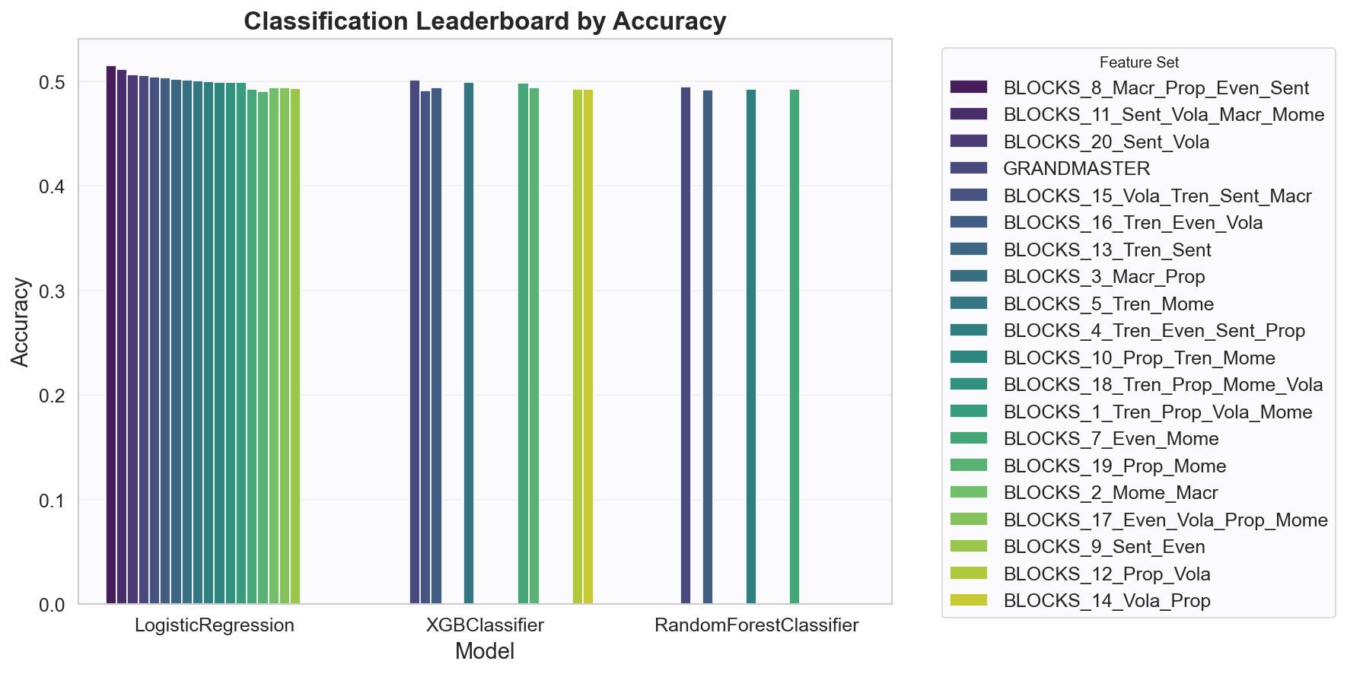
“Model Zoo” Experiment- Framework

Slide 10
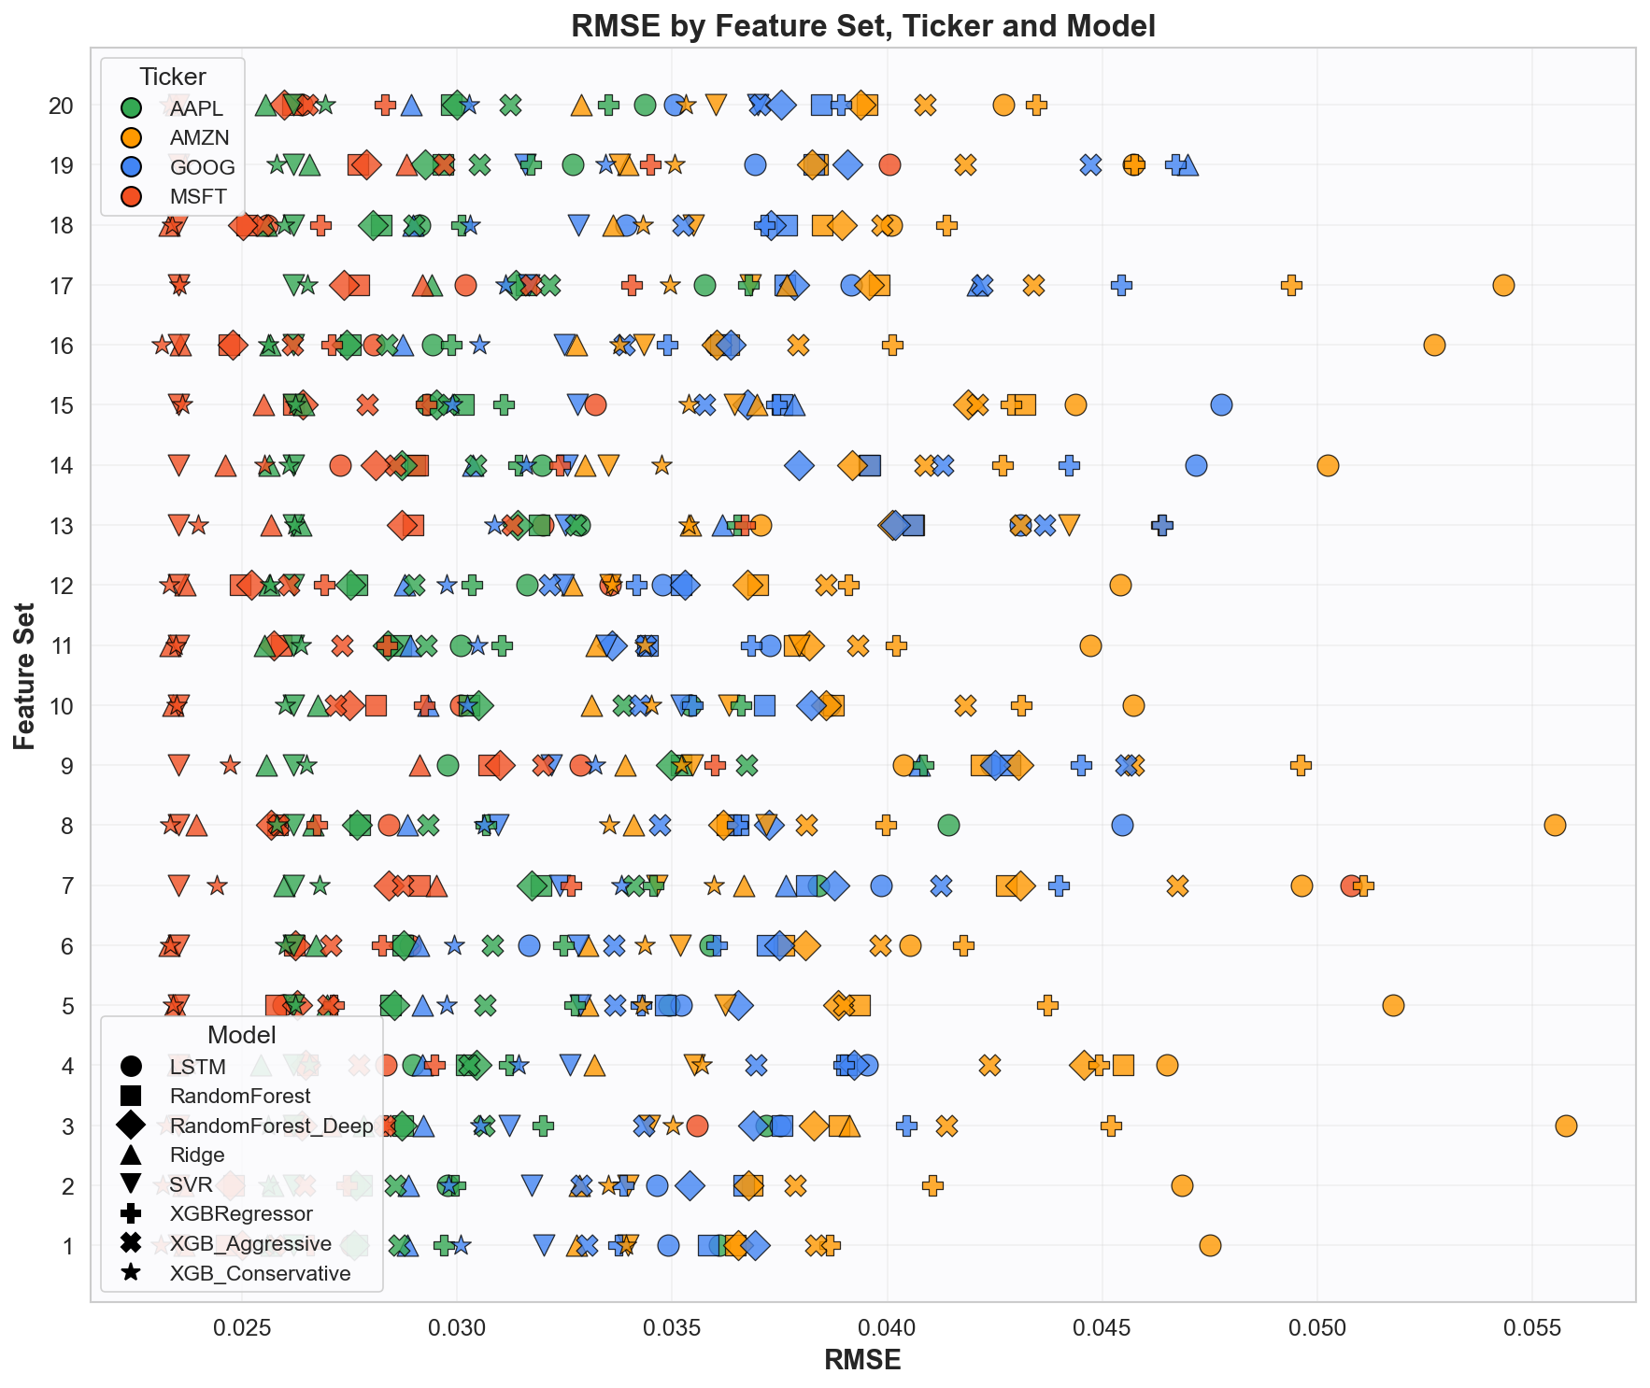
“Model Zoo” Experiment- Results
Continuous run

Slide 11
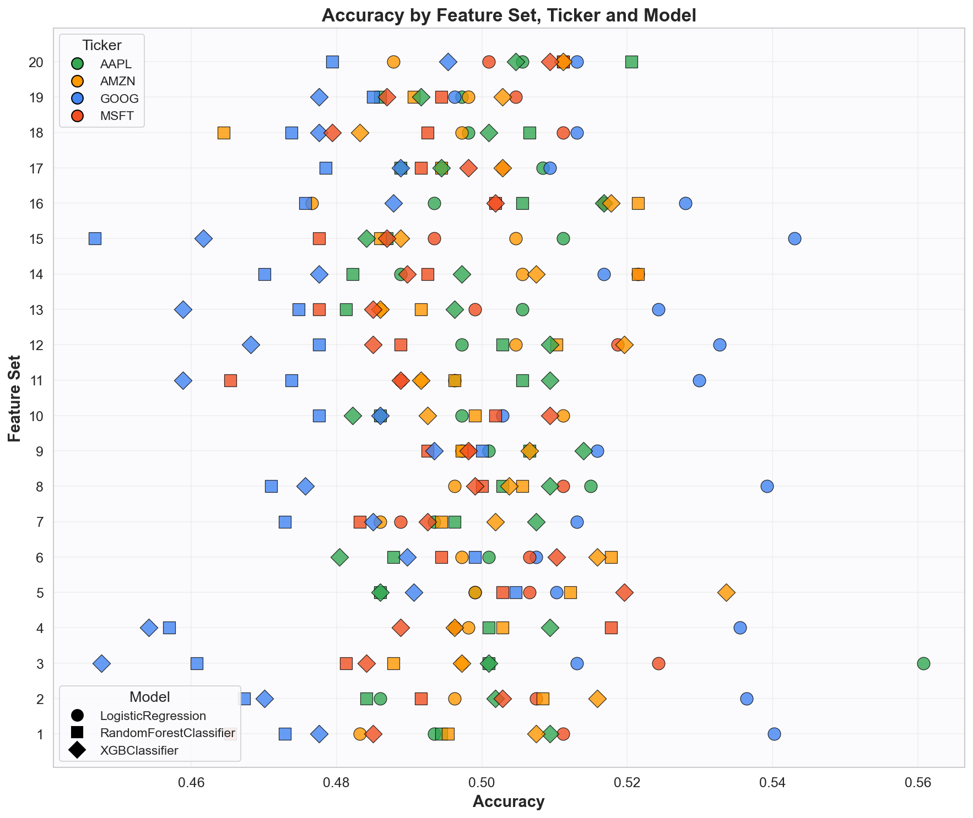
“Model Zoo” Experiment- Results
Discrete run

Slide 12
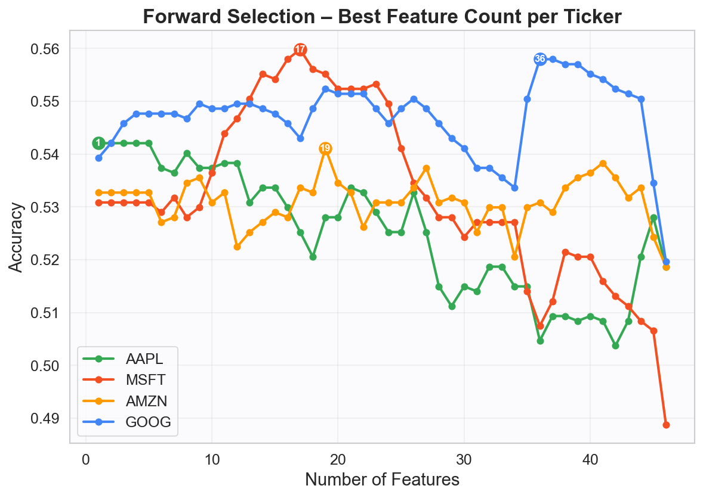
Feature Selection
Wrapper method – forward selection

Slide 13
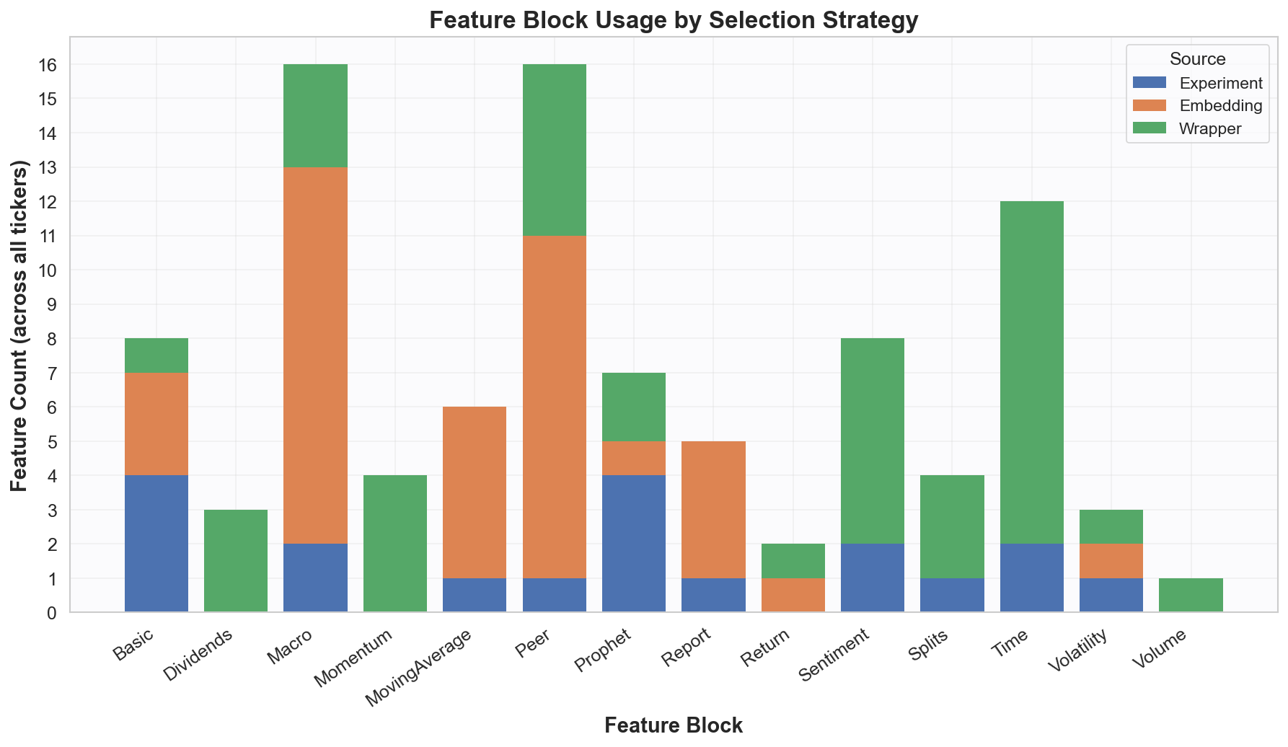
Feature Selection
Wrapper method – forward selection
Comparing top features from strategies

Slide 14
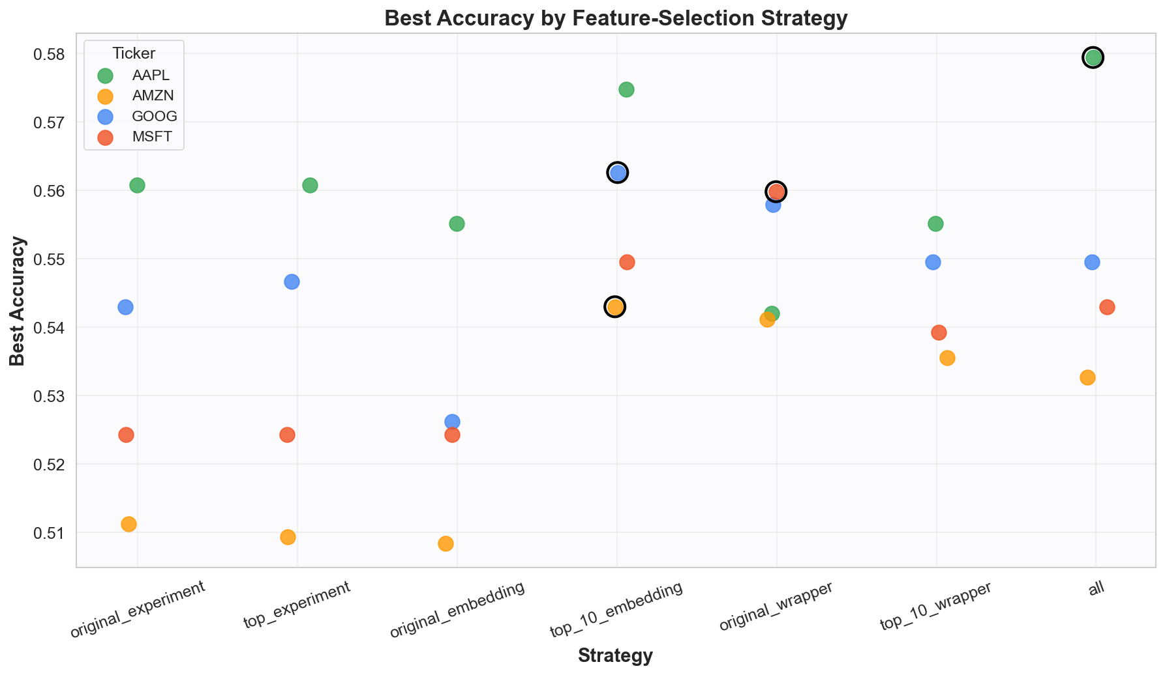
Feature Selection
Wrapper method – forward selection
Comparing top features from strategies

Slide 15
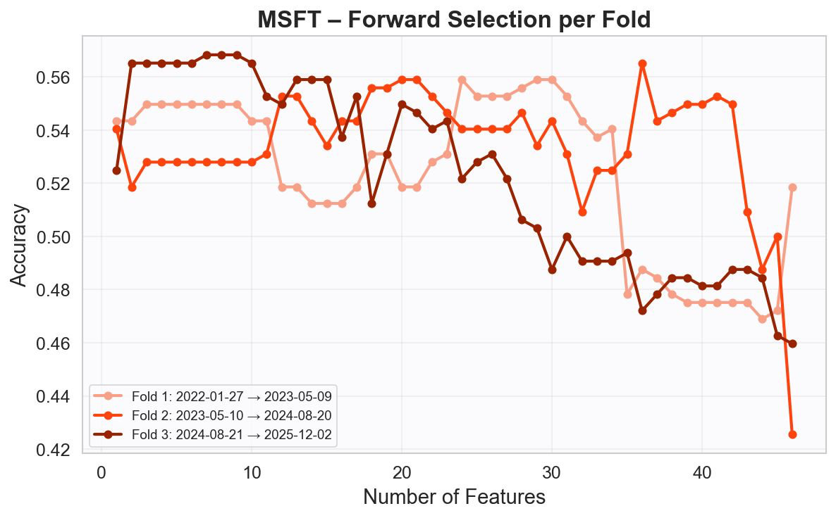
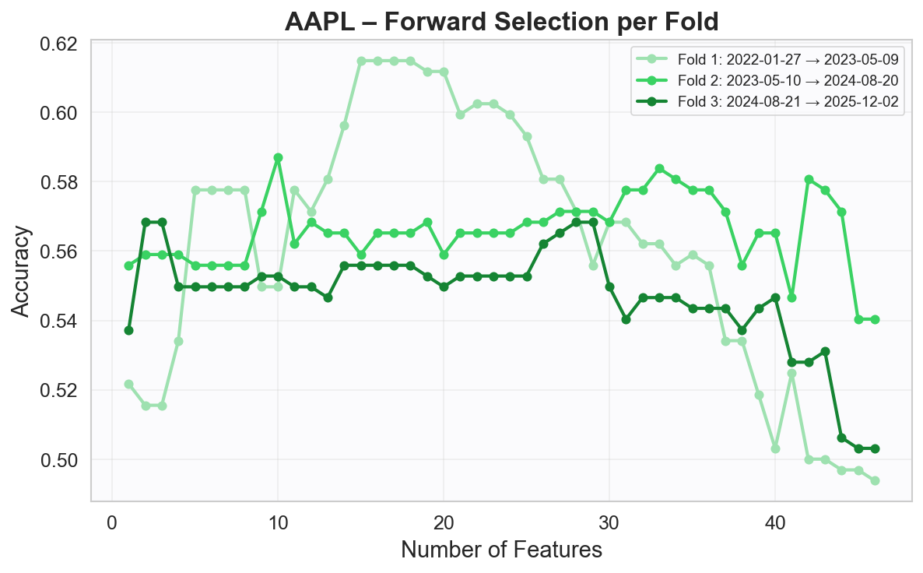
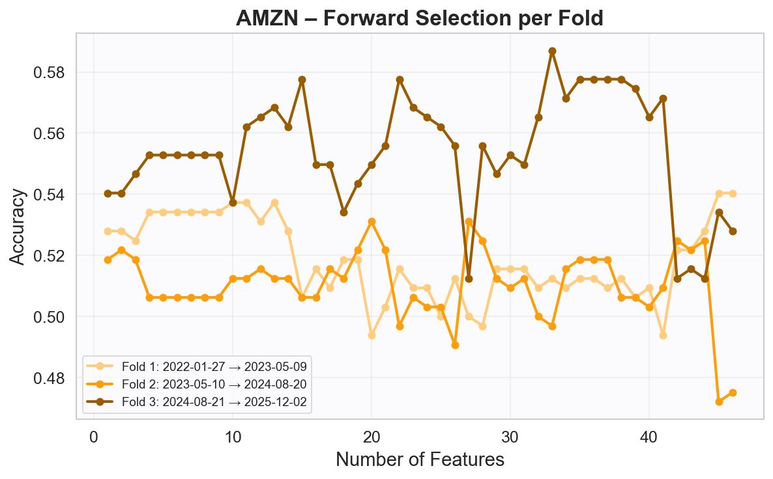
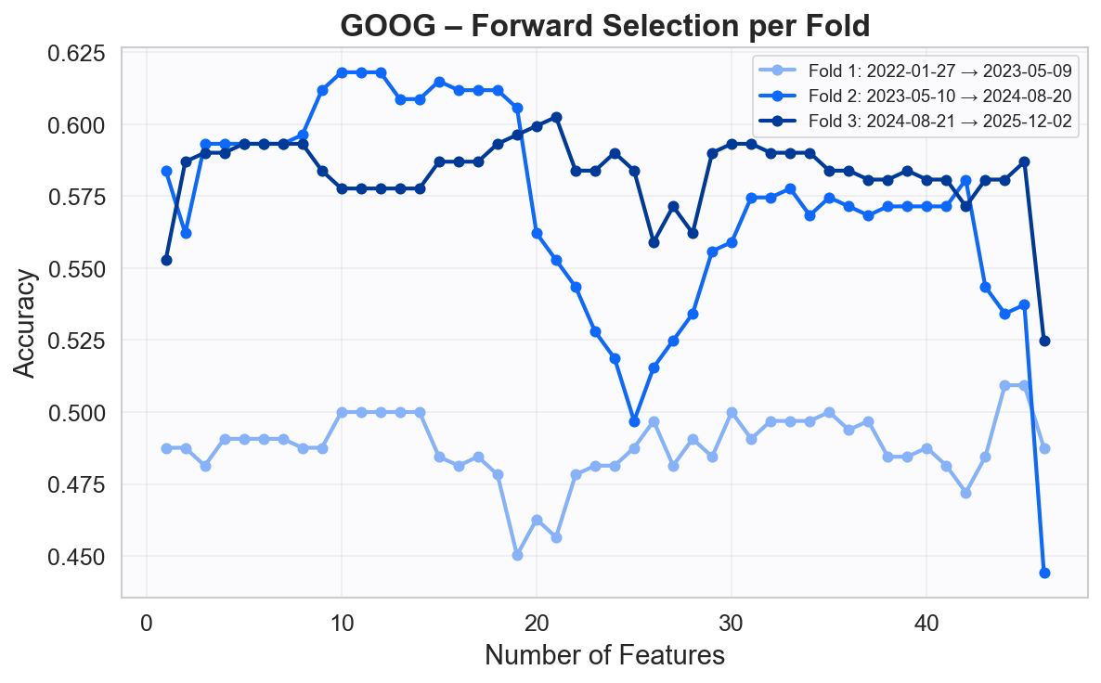
Feature Selection
Wrapper method – forward selection
Comparing top features from strategies
Per fold

Slide 16
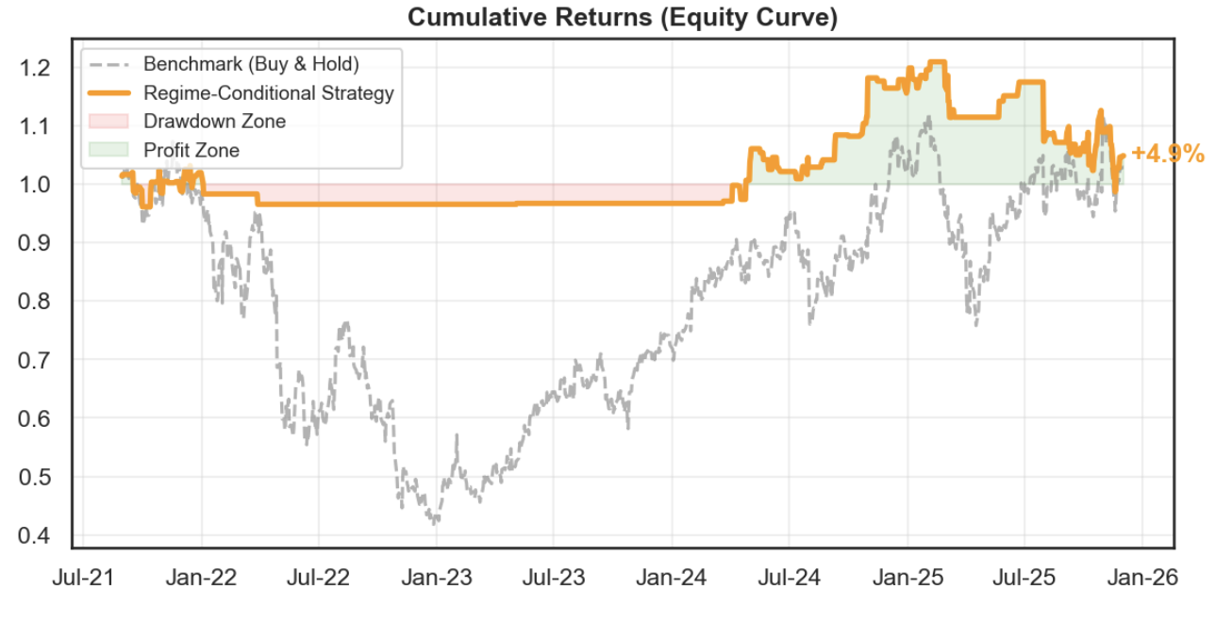
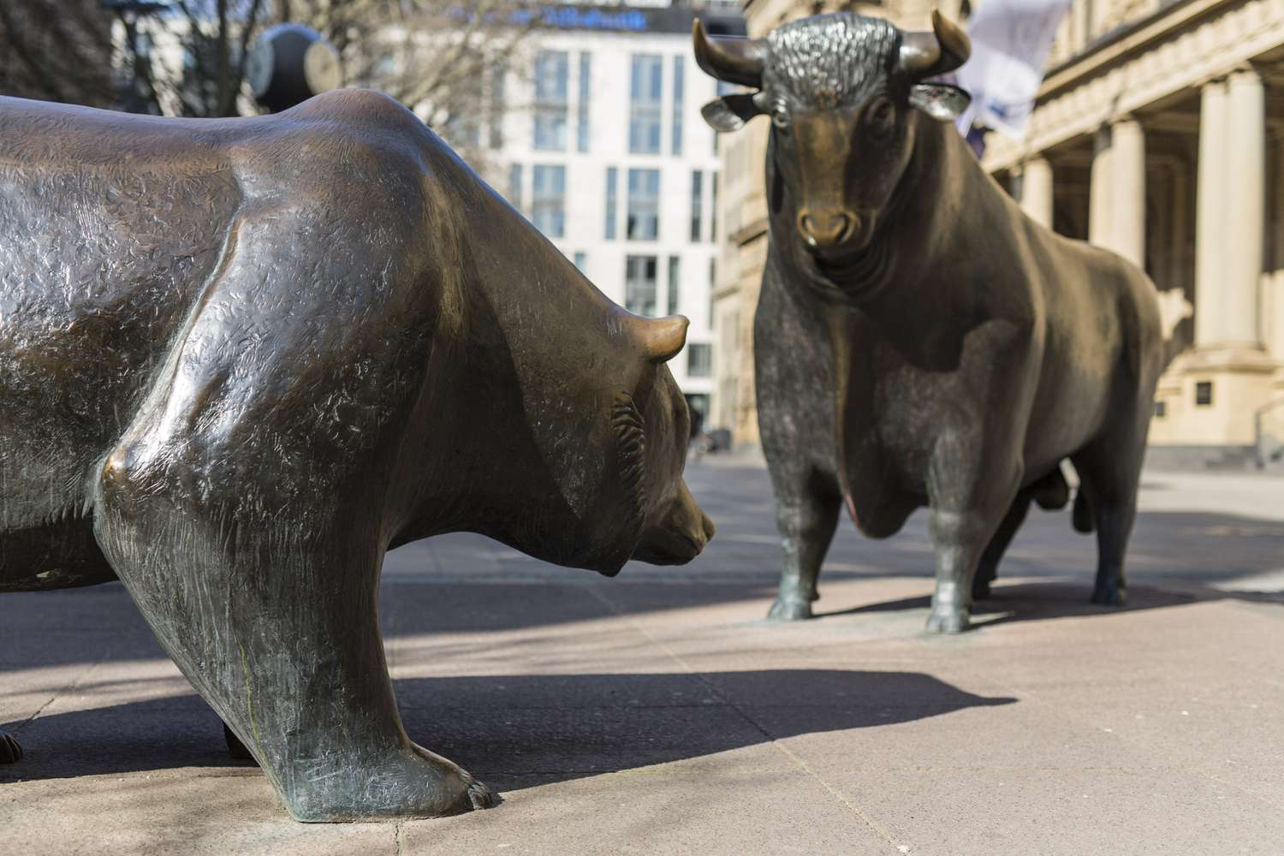
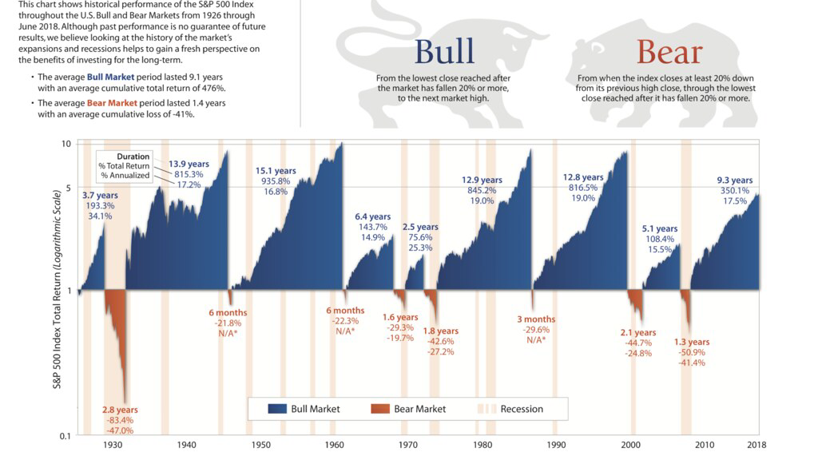
Future Direction: Bull And Bear Regimes

Slide 17
Project status- Finished tasks
Data Preparation:
Data Access
EDA
Feature Engineering
Evaluation:
Benchmarks and Success Criteria
Model Selection:
Experiment
Feature Selection

Slide 18
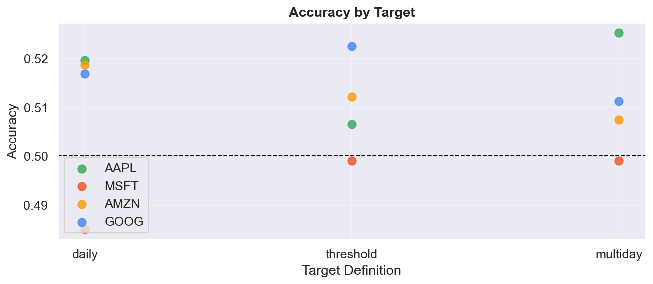
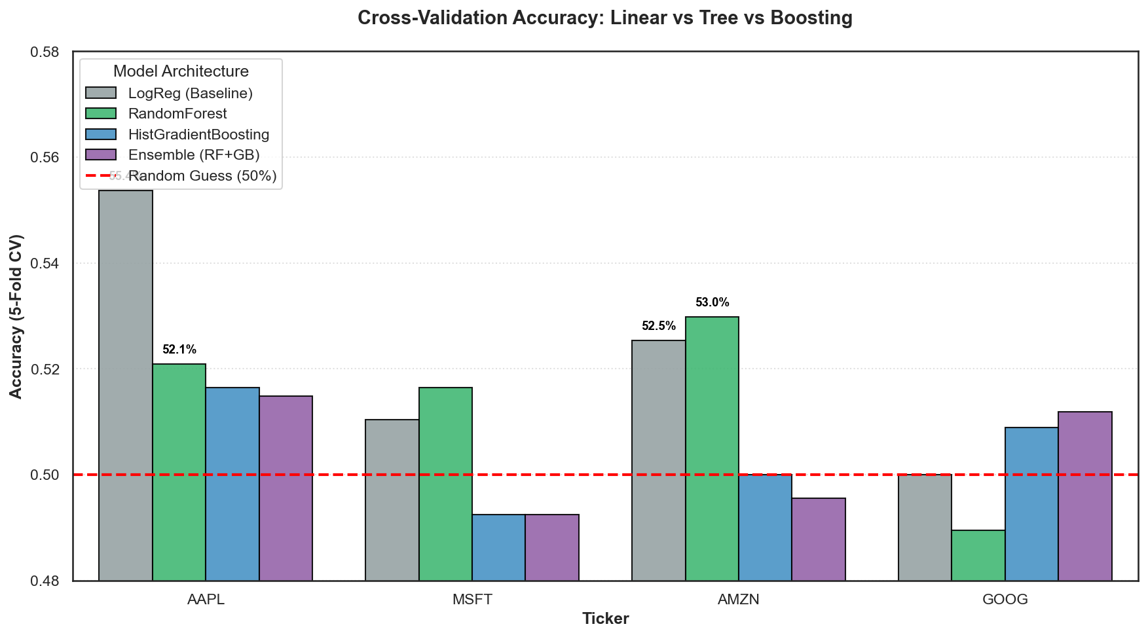
Project status – Future Directions
Remaining Tasks Before Submission:
Code debugging and cleaning
Notebook Order and Plotting Improvements
Explainability
Discussion
Additional Deep Dive Directions:
Focus on RandomForest
Target horizon exploration
Bull & Bear regimes
Continuous run against baseline
Explore difference between folds

Slide 19

Thank you, Questions?

